Slide 1
IMPLEMENTATION AND MAINTENANCE OF THE WATER RECONCILIATION STRATEGY FOR THE WESTERN CAPE WATER SUPPLY SYSTEM
PRESENTER: Desire Sibanda/A Singh
Thursday, 8th March 2018

Slide 2
INTRODUCTION
The Western Cape Water Supply System (WCWSS) supplies a population of more than 3 million people in the Greater Cape Town.
Communities served are
City of Cape Town,
Boland,
West Coast
Swartland
Overberg
Irrigators along the Berg, Eerste and Riviersonderend rivers
The WCWSS is operated as an integrated WSS.

Slide 3
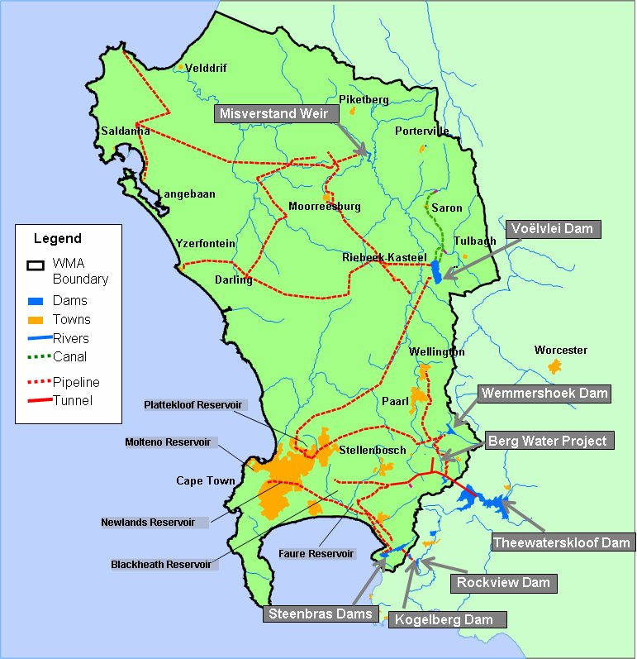
WCWSS FOOTPRINT

Slide 4
INTRODUCTION
The overall objective of this project is
To facilitate the reconciliation of predicted future water requirements with supply available from the WCWSS and other sources for a rolling 25-year horizon.
A full update of the strategy input data is required, to ensure that the strategy and its recommendations are current, pertinent and applicable

Slide 5
STUDY TEAM
The joint venture comprise of the following companies:
  NFM Multi Consulting
  Tlou Consulting (Pty) Ltd.
The joint venture will be supported by the following specialists:
  Aurecon (Pty) Ltd
  Groundwater Africa
Notes:
1) NFM Multi Consulting /Tlou Consulting (Pty) Ltd Joint Venture will be responsible for project management, data collation, water requirements, water balance assessment, training, stakeholder liaison and meetings administrative requirements, water quality, water resource protection, Reserve and resource quality objectives, media and ad-hoc support as needed.
2) Aurecon (Pty) Ltd will provide technical study leadership and review, water resource updates and technical aspects of desalination and reuse of water and will do training.
3) Groundwater Africa is the specialist groundwater consultant.

Slide 6
STUDY TEAM
D Sibanda
Project Manager
C Sellick
Internal Reviewer
T Tlou
Task Leader:
Scenario Planning& Intervention
A Spark
Task Leader: Systems Analysis
C Mutero
Task Leader: Updated Water Requiremens
R Moodley
Task Leader: Water balance
R Murray
Task Leader: Groundwater Assessments
J Cullis
Task Leader : Climate Change
A Singh
Task Leader: Stakeholder Engagement
A Singh
Task Leader: Water Resource Quality
D Mullins
Task Leader: Socio Economic Assessment
L Koen
Task Leader: Desalination & Reuse
M Killick
Technical Study
Leader
DWS Project Manager
T.S Makombe
ATSG
SSC

Slide 7
PROJECT APPROACH AND METHODOLOGY
It is envisaged that four work packages are required for the implementation and maintenance of the water reconciliation strategy for the WCWSS.
Work Package 1: Project Inception
Work Package 2: Improvement and updating of the reconciliation strategies
Work Package 3: Stakeholder Engagement
Work Package 4: Capacity Building and Training

Slide 8
WORK PACKAGE 1: INCEPTION
Clarify objectives, methodology and deliverables
Review existing available information.
Hold discussions with DWS and other key stakeholders
Finalisation of scope of work and providing a refined project approach.
Deliverables: Inception Meeting, Literature Review Report, Inception Report & Presentation

Slide 9
WORK PACKAGE 2: IMPROVE AND UPDATE THE RECONCILIATION STRATEGY
Water Requirements
  Drivers of water requirements in Cape Town has been the population and economic growth
  Gather information from City of Cape Town and Western Cape Provincial Government on the indicators
  Compare indicators with baseline indicators in the previous study
  Evaluate the impact of the validation and verification exercises
  Compare actual water requirements with the future water requirement scenarios
  Monitor actual water requirements and provide feedback to the SSC
  Monitor growth in water requirements in winter months.
Notes:
Should the assumptions and resultant water requirement projections differ significantly from the baseline assumptions, it may be necessary for the CCT to initiate a study to update the future water requirement projections.
It is proposed that the future water requirements for irrigated agriculture remain as was proposed in the original WCWSS Reconciliation Strategy Study and that the agricultural sector be allowed to grow into the capped allocation
The purpose of this reporting will be to timeously identify any deviations of actual water requirements relative to the projected future water requirement scenarios, notably the influence of WC/WDM and the influence of drought measures.

Slide 10
WORK PACKAGE 2: IMPROVE AND UPDATE THE RECONCILIATION STRATEGY
Monitor Water Resources Availability
  Gather information on the changes in the supply from WCWSS water sources
  Update yield from these sources
  This will provide an indication of the water balance situation
Monitor Strategy Implementation
  Review and update periodically the Reconciliation Strategy
  Update Scenario Planning annually
  Draft Terms of Reference for a Strategy update, for approval by the SG and SSC if major updates are required.
  Update information on the Action Plan developed as part of the Reconciliation Strategy

Slide 11
WORK PACKAGE 2: IMPROVE AND UPDATE THE RECONCILIATION STRATEGY
Liaison with Steering Committee Representatives to ensure
  the latest information is available for use in the Scenario Planning exercise;
  progress reports are timeously submitted by the institutions undertaking studies for which feedback reports to the Strategy Steering Committee (SSC) are required;
  concerns of representatives are tabled at the Support Group Meetings and at the Steering Committee meetings; and that
  actions are understood, communicated and implemented
Scenario Planning and Strategy Update
  Update annually the supply side interventions and revised WC/WDM programme
  Evaluate compliance and progress against set targets and report deviations to SG and SSC
  Update the Reconciliation Support Tool to suit the needs of scenario planning process
  Draft Annual Progress Report
Notes:
It is proposed that key Scenarios collectively be identified by DWA, the Steering Committee and/or the Support Group and that these key Scenarios are re-evaluated on an annual basis or when new or relevant information becomes available. In addition to reporting on the supply scenarios, actual usage and the status of the various studies / implementation of interventions will also be reported upon. The results will be presented to the SSC for comment and/or adoption. The following will have to be taken into consideration:
• Latest CCT WC/WDM initiatives
• The latest CCT, water service authority and agricultural water requirements
• Progress with regards to key interventions such as the Voëlvlei Augmentation Scheme, Desalination Feasibility Study, Water Re-use Feasibility Study, TMG Aquifer Feasibility Study etc.
An Annual Progress (Status) Report will be drafted.

Slide 12
WORK PACKAGE 2: IMPROVE AND UPDATE THE RECONCILIATION STRATEGY
Document review
  Review reports and proposals provided to the SSC for information and comment and submit to TSG and SSC. (Potential Schemes, Additional Interventions, Climate Change etc)
Water Resource Protection and Resource Classification
  Attend where appropriate workshops and meetings where water resource protection measures are discussed.
  Monitor effectiveness of water quality monitoring in rivers, dams, water treatment works and wastewater treatment works
Scientific and Technical Support
  Additional specialist services may be utilised as and when required by the TSG or by the SSC
  Ad-hoc support to CE:NWRP(S)

Slide 13
WORK PACKAGE 3: STAKEHOLDER ENGAGEMENT AND COMMUNICATION
Re-establish Strategy Steering Committee (SSC), Technical Support Group (TSG) and Study Administration Committee (SAM)
Stakeholder Consultation through SSC to communicate progress on strategy implementation.
  6 meetings to be held
  Draft ToR for the SSC for new members
Provide administrative, scientific, and technical assistance to the SSC and the TSG
  TSG to be formed by DWS, and other nominated members
  12 meetings for the TSG
  Preparation of minutes and distribution of documents
  Prepare the Status Report (September Progress Report)
  Prepare March Progress Report – Summary of issues discussed at March SSC

Slide 14
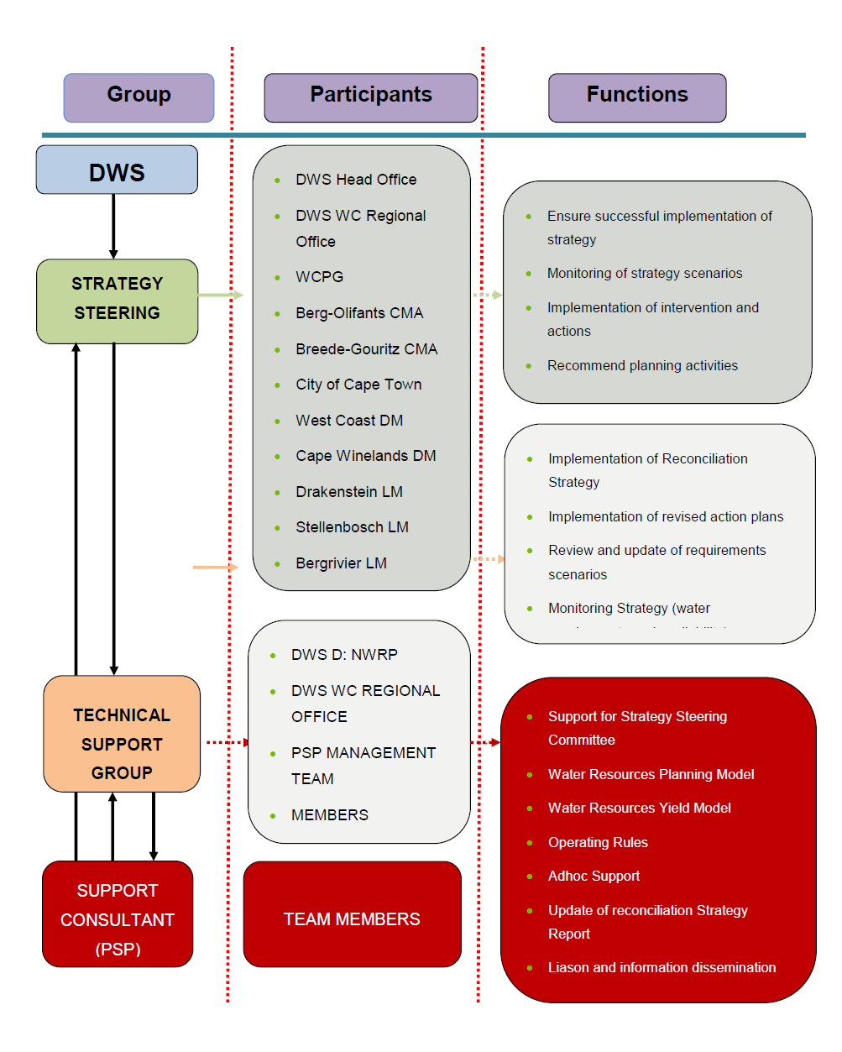
WORK PACKAGE 3: STAKEHOLDER ENGAGEMENT AND COMMUNICATION

Slide 15
WORK PACKAGE 4: CAPACITY BUILDING AND TRAINING
Provide Training and technology transfer to DWS officials and nominated individuals from the study area
  A formal 2-day training course to provide attendees with general background of the processes involved with developing and implementing a reconciliation strategy.
  Training of individuals in the practical aspects of the study
    Hydrological analysis (11.5 days of participation)
    Water requirements and return flows (4.5 days of participation)
    Water balance (1 day of participation)
    Yield analysis (WRYM) (2.5 days of participation)
    Planning analysis (WRPM) (8 days of participation)
  A Capacity Building and Training Plan will be developed and submitted for approval.

Slide 16
PROJECT MANAGEMENT AND DELIVERABLES
# | Deliverable items | Due Date (Del month or date)
1 | Capacity Building and Training Plan | 2
2 | Inception Meeting and Report (incl. literature review) | 3
3 | Technical Support Group meetings | At least 12 times (Mar, April, Sep, Dec)
4 | Study Steering Committee meetings | 6 times (Mar, Sep)
5 | Status Report (annually) | 3 times (Sep)
6 | Progress Report (annually) | 3 times (Mar)
7 | Capacity Building and Training progress reporting | Every 12 months (3 times)
8 | Capacity building and Training Report | 36
9 | Project Closure Report | 36
10 | Ad-hoc support to NWRP Planning (South) | As per agreements to be concluded
11 | Project Management, Communication and Admin meetings (incl. Study Administration meetings, Issues and Response register, newsletters, media releases and updating of the DWS WCWSS Reconciliation internet page content) | Every 3 months (12 times)

Slide 17
PROJECT MANAGEMENT AND DELIVERABLES
Note: Please see the handout

Slide 18
THANK YOU

